Slide 1

CITY OF NORMAN
pre-proposal meeting
Rfp 2223-29
comprehensive plan and Master Plans
NOVEMBER 3, 2022

Slide 2

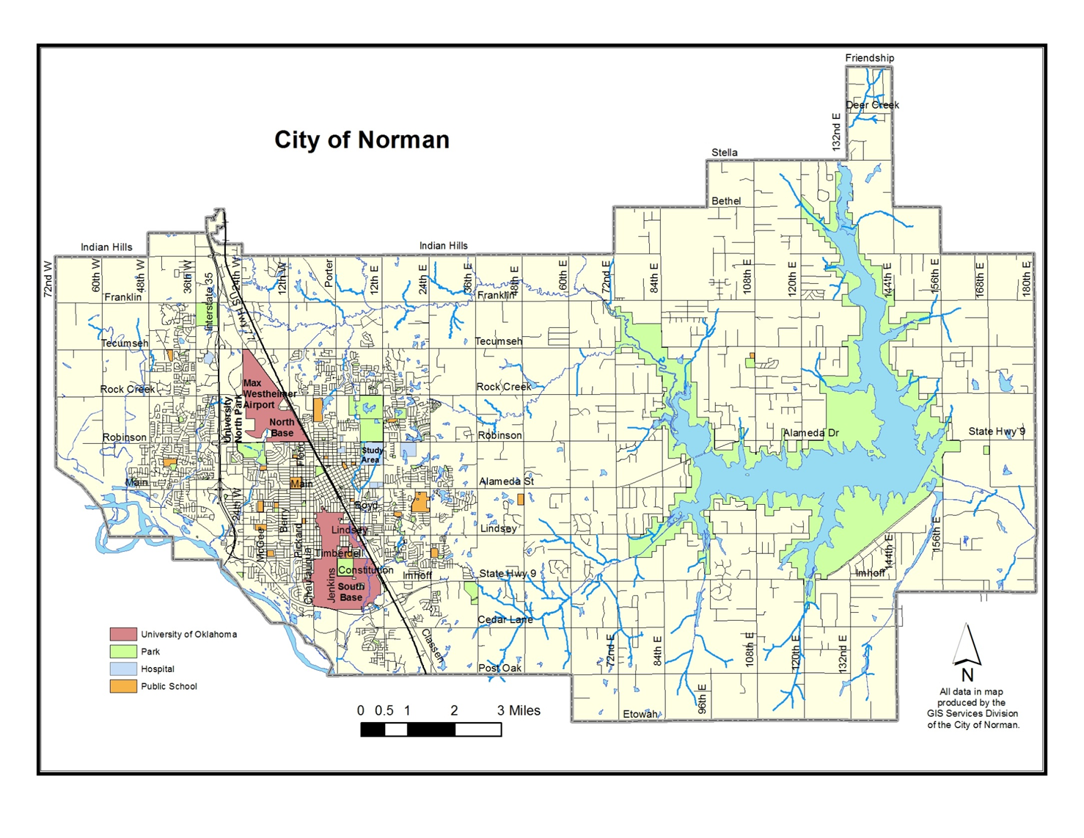
189.2 Sq. Mi.

Slide 3
Norman Community History & Background
Established in 1889 and incorporated in 1891
Located in Oklahoma City Metro Area
Population - 131,500
Third largest city in Oklahoma
189.2 Square Miles, more than half is rural
University of Oklahoma (OU)
  Established in 1890
  Approximately 29,000 students, 2,400 faculty and 12,000 employees
  Southeastern Conference for athletics in 2025

Slide 4
Norman Attractions
OU Sporting Events
Sam Noble Museum of Natural History
National Weather Center – Storm Prediction Center, National Severe Storms Lab, National Oceanic Atmospheric Administration
Fred Jones Museum of Art
Second Friday Art Walk
Norman Festivals – Norman Music Fest, Medieval Fair, National Weather Festival, Downtown Norman Fall Fest, Jazz in June

Slide 5
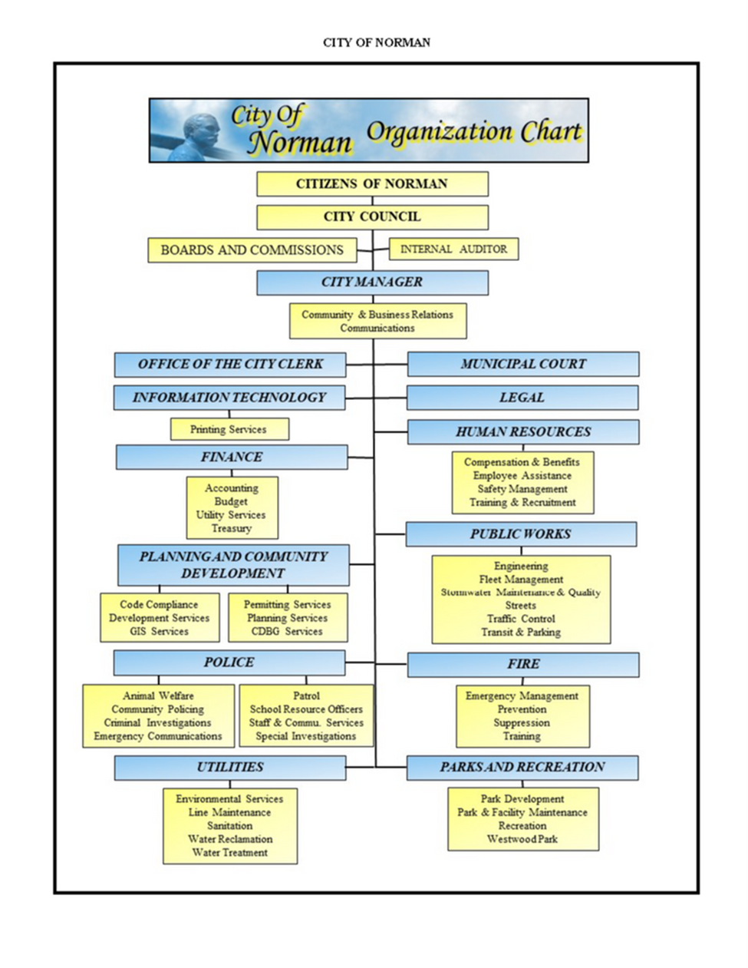
City of Norman

Slide 6
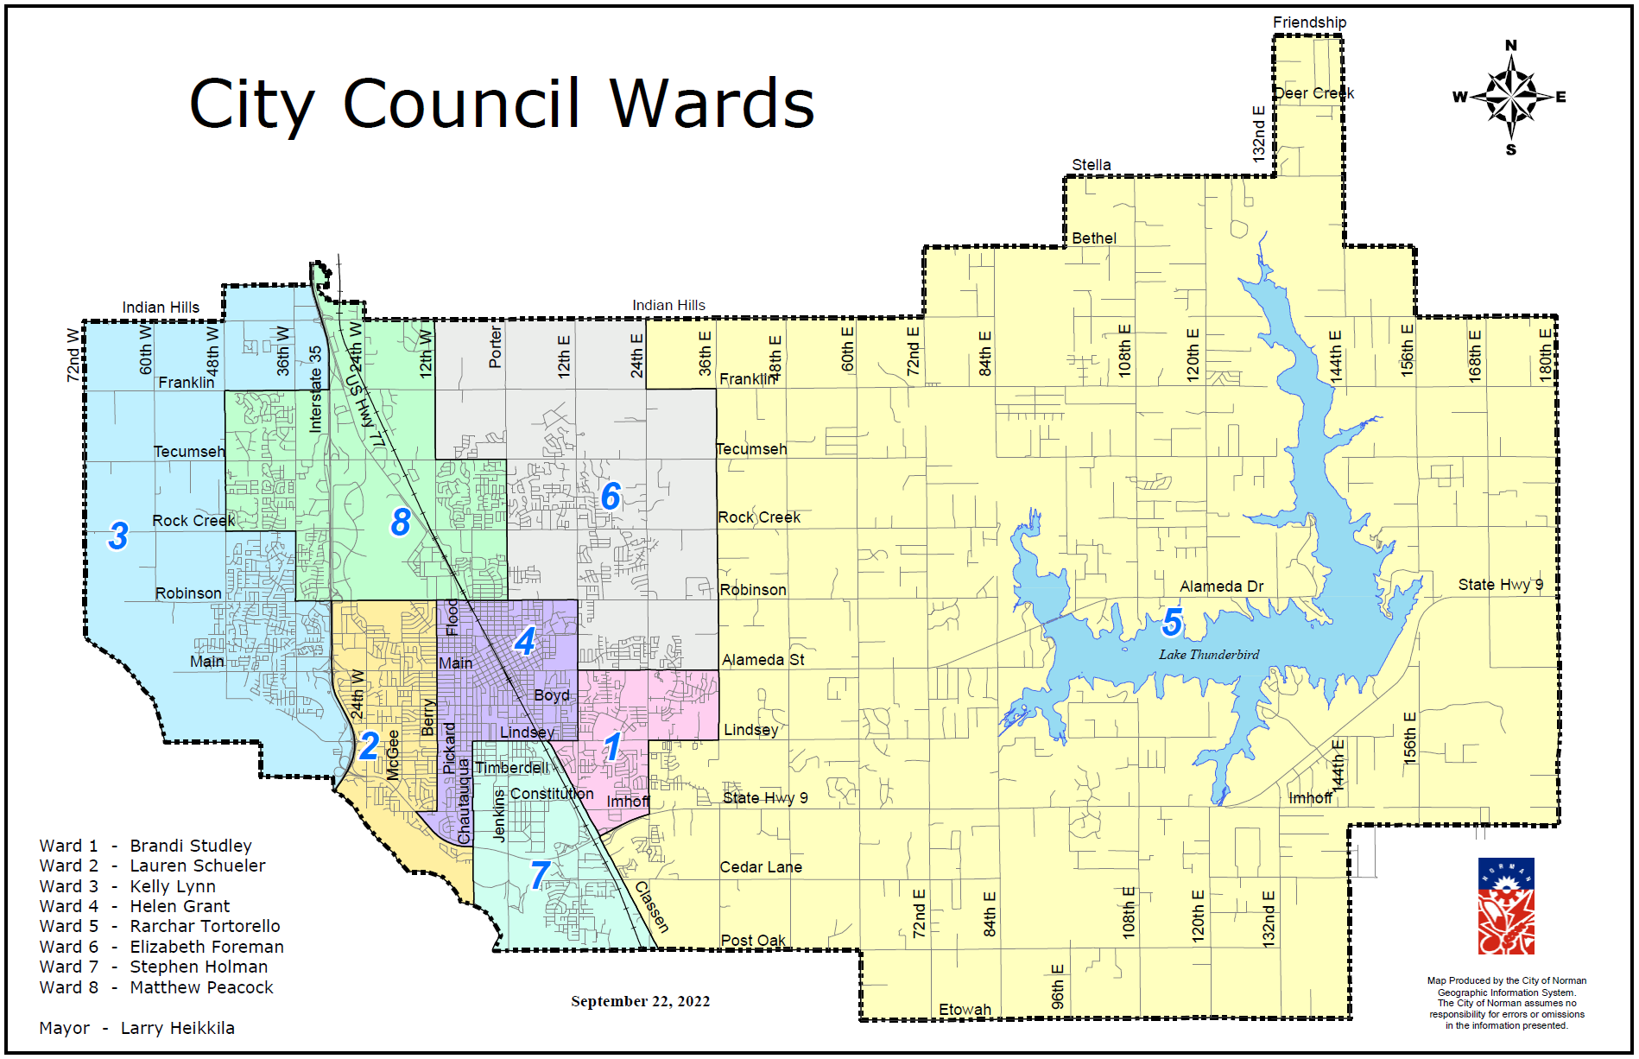

Slide 7
Planning Background
Norman 2025 Comprehensive Plan – 2004
Zoning Ordinance – 1954/1973
Subdivision Regulations – 1957
Housing Market Analysis – 2015
PlanNorman 2018 – Not adopted

Slide 8
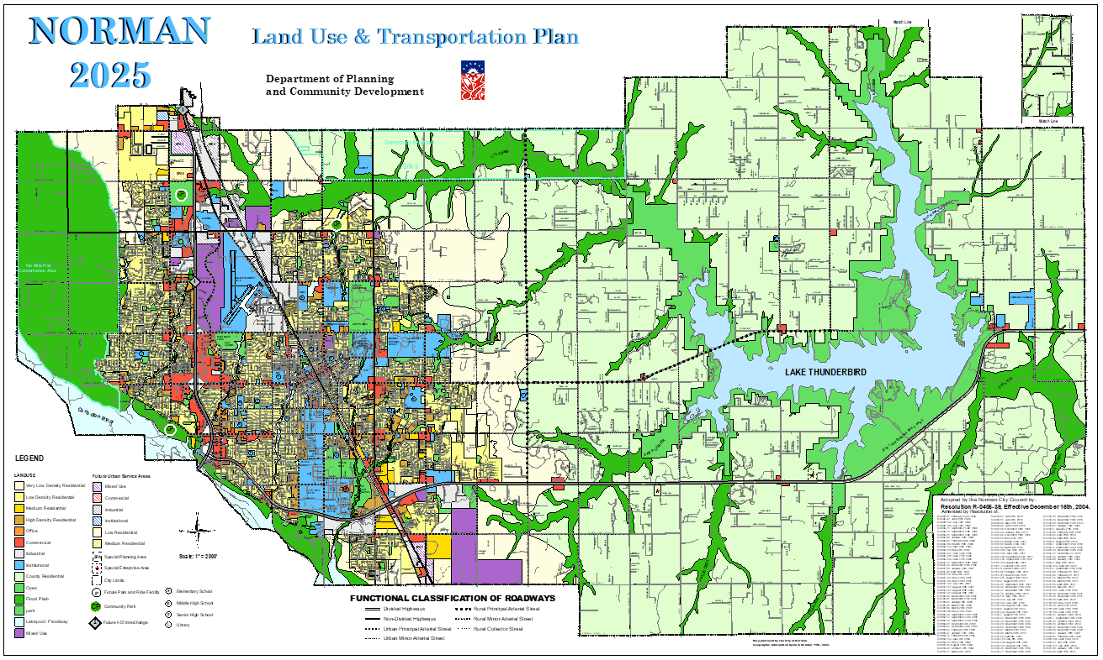

Slide 9
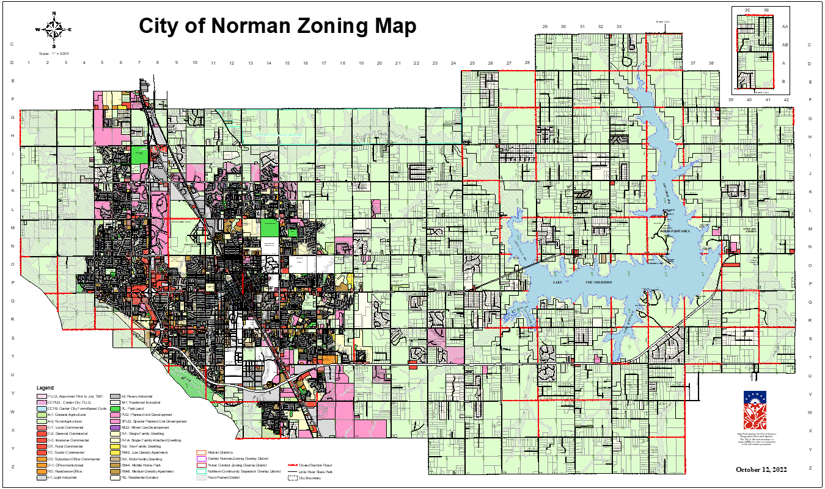
27 Zoning Districts with 5 Overlay Districts

Slide 10
Other City Master Plans
Wastewater Master Plan – 2001
Stormwater Master Plan – 2009
Greenway Master Plan – 2009
Parks Master Plan – 2009
Strategic Water Supply Plan – 2014
Comprehensive Transportation Plan – 2014
Wastewater Flow Monitoring & Modeling – 2018

Slide 11

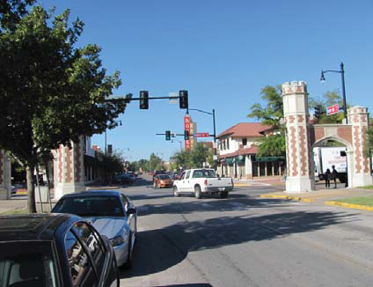
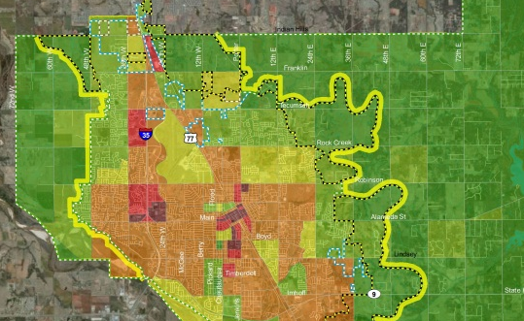
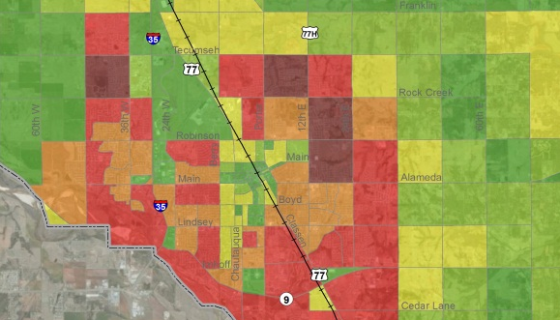
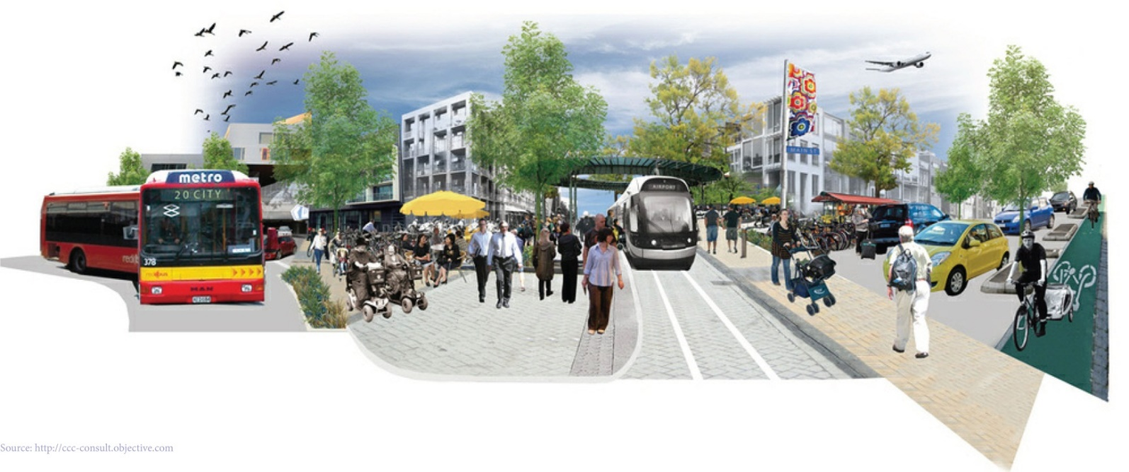


The Norman Comprehensive
Transportation Plan (CTP)
<?xml version="1.0"?><AllQuestions />
<?xml version="1.0"?><Settings><answerBulletFormat>Numeric</answerBulletFormat><answerNowAutoInsert>No</answerNowAutoInsert><answerNowStyle>Explosion</answerNowStyle><answerNowText>Answer Now</answerNowText><chartColors>Use PowerPoint Color Scheme</chartColors><chartType>Horizontal</chartType><correctAnswerIndicator>Checkmark</correctAnswerIndicator><countdownAutoInsert>No</countdownAutoInsert><countdownSeconds>10</countdownSeconds><countdownSound>TicToc.wav</countdownSound><countdownStyle>Box</countdownStyle><gridAutoInsert>No</gridAutoInsert><gridFillStyle>Answered</gridFillStyle><gridFillColor>0,0,0</gridFillColor><gridOpacity>100%</gridOpacity><gridTextStyle>Keypad #</gridTextStyle><inputSource>Response Devices</inputSource><multipleResponseDivisor># of Responses</multipleResponseDivisor><participantsLeaderBoard>5</participantsLeaderBoard><percentageDecimalPlaces>0</percentageDecimalPlaces><responseCounterAutoInsert>No</responseCounterAutoInsert><responseCounterStyle>Oval</responseCounterStyle><responseCounterDisplayValue># of Votes Received</responseCounterDisplayValue><insertObjectUsingColor>Blue</insertObjectUsingColor><showResults>Yes</showResults><teamColors>User Defined</teamColors><teamIdentificationType>None</teamIdentificationType><teamScoringType>Voting pads only</teamScoringType><teamScoringDecimalPlaces>1</teamScoringDecimalPlaces><teamIdentificationItem></teamIdentificationItem><teamsLeaderBoard>5</teamsLeaderBoard><teamName1></teamName1><teamName2></teamName2><teamName3></teamName3><teamName4></teamName4><teamName5></teamName5><teamName6></teamName6><teamName7></teamName7><teamName8></teamName8><teamName9></teamName9><teamName10></teamName10><showControlBar>Slides with Get Feedback Objects</showControlBar><defaultCorrectPointValue>100</defaultCorrectPointValue><defaultIncorrectPointValue>0</defaultIncorrectPointValue><chartColor1>187,224,227</chartColor1><chartColor2>51,51,153</chartColor2><chartColor3>0,153,153</chartColor3><chartColor4>153,204,0</chartColor4><chartColor5>128,128,128</chartColor5><chartColor6>0,0,0</chartColor6><chartColor7>0,102,204</chartColor7><chartColor8>204,204,255</chartColor8><chartColor9>255,0,0</chartColor9><chartColor10>255,255,0</chartColor10><teamColor1>187,224,227</teamColor1><teamColor2>51,51,153</teamColor2><teamColor3>0,153,153</teamColor3><teamColor4>153,204,0</teamColor4><teamColor5>128,128,128</teamColor5><teamColor6>0,0,0</teamColor6><teamColor7>0,102,204</teamColor7><teamColor8>204,204,255</teamColor8><teamColor9>255,0,0</teamColor9><teamColor10>255,255,0</teamColor10><displayAnswerImagesDuringVote>Yes</displayAnswerImagesDuringVote><displayAnswerImagesWithResponses>Yes</displayAnswerImagesWithResponses><displayAnswerTextDuringVote>Yes</displayAnswerTextDuringVote><displayAnswerTextWithResponses>Yes</displayAnswerTextWithResponses><questionSlideID></questionSlideID><controlBarState>Expanded</controlBarState><isGridColorKnownColor>True</isGridColorKnownColor><gridColorName>Yellow</gridColorName><AutoRec></AutoRec><AutoRecTimeIntrvl></AutoRecTimeIntrvl><chartVotesView>Percentage</chartVotesView><chartLabelsColor>0,0,0</chartLabelsColor><isChartLabelColorKnownColor>True</isChartLabelColorKnownColor><chartLabelColorName>Black</chartLabelColorName><chartXAxisLabelType>Full Text</chartXAxisLabelType></Settings>
<?xml version="1.0"?><AllAnswers />
Adopted by Norman City Council
April 2014

Slide 12
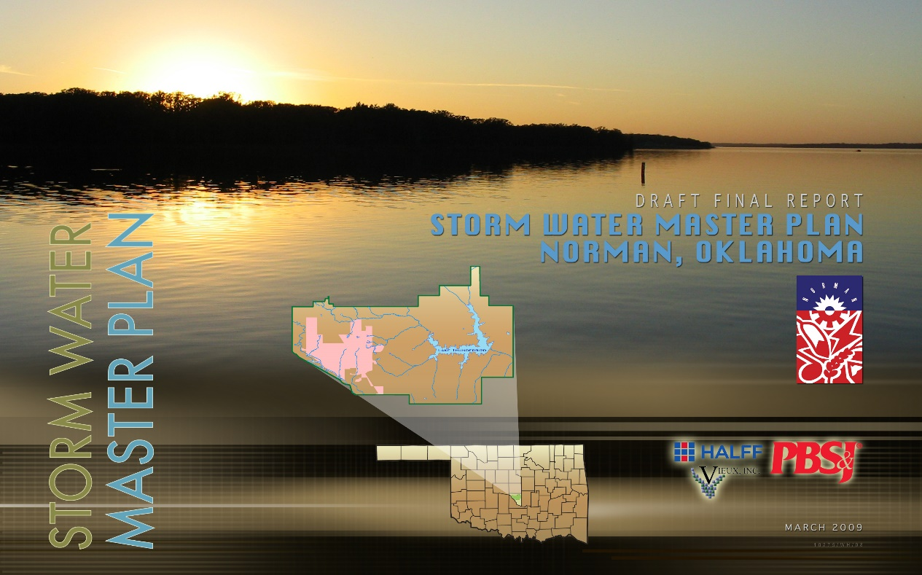
Stormwater Master Plan
Adopted by Norman City Council
November, 2009

Slide 13
Stormwater Study Areas

Slide 14
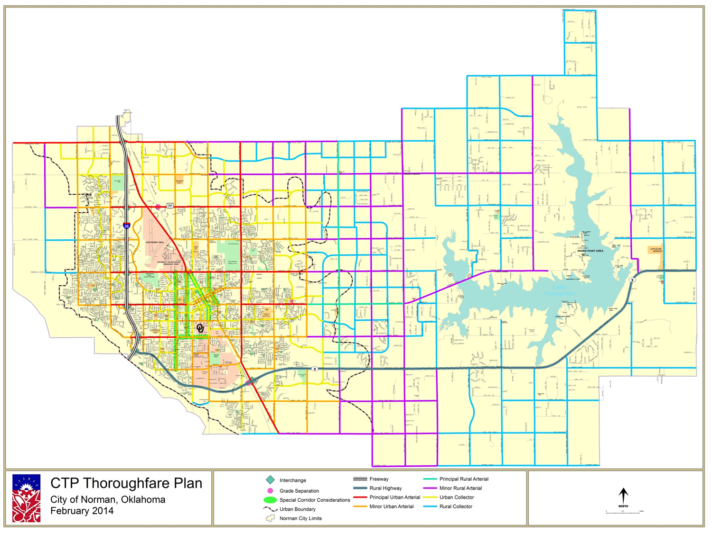
<?xml version="1.0"?><AllQuestions />
<?xml version="1.0"?><Settings><answerBulletFormat>Numeric</answerBulletFormat><answerNowAutoInsert>No</answerNowAutoInsert><answerNowStyle>Explosion</answerNowStyle><answerNowText>Answer Now</answerNowText><chartColors>Use PowerPoint Color Scheme</chartColors><chartType>Horizontal</chartType><correctAnswerIndicator>Checkmark</correctAnswerIndicator><countdownAutoInsert>No</countdownAutoInsert><countdownSeconds>10</countdownSeconds><countdownSound>TicToc.wav</countdownSound><countdownStyle>Box</countdownStyle><gridAutoInsert>No</gridAutoInsert><gridFillStyle>Answered</gridFillStyle><gridFillColor>0,0,0</gridFillColor><gridOpacity>100%</gridOpacity><gridTextStyle>Keypad #</gridTextStyle><inputSource>Response Devices</inputSource><multipleResponseDivisor># of Responses</multipleResponseDivisor><participantsLeaderBoard>5</participantsLeaderBoard><percentageDecimalPlaces>0</percentageDecimalPlaces><responseCounterAutoInsert>No</responseCounterAutoInsert><responseCounterStyle>Oval</responseCounterStyle><responseCounterDisplayValue># of Votes Received</responseCounterDisplayValue><insertObjectUsingColor>Blue</insertObjectUsingColor><showResults>Yes</showResults><teamColors>User Defined</teamColors><teamIdentificationType>None</teamIdentificationType><teamScoringType>Voting pads only</teamScoringType><teamScoringDecimalPlaces>1</teamScoringDecimalPlaces><teamIdentificationItem></teamIdentificationItem><teamsLeaderBoard>5</teamsLeaderBoard><teamName1></teamName1><teamName2></teamName2><teamName3></teamName3><teamName4></teamName4><teamName5></teamName5><teamName6></teamName6><teamName7></teamName7><teamName8></teamName8><teamName9></teamName9><teamName10></teamName10><showControlBar>Slides with Get Feedback Objects</showControlBar><defaultCorrectPointValue>100</defaultCorrectPointValue><defaultIncorrectPointValue>0</defaultIncorrectPointValue><chartColor1>187,224,227</chartColor1><chartColor2>51,51,153</chartColor2><chartColor3>0,153,153</chartColor3><chartColor4>153,204,0</chartColor4><chartColor5>128,128,128</chartColor5><chartColor6>0,0,0</chartColor6><chartColor7>0,102,204</chartColor7><chartColor8>204,204,255</chartColor8><chartColor9>255,0,0</chartColor9><chartColor10>255,255,0</chartColor10><teamColor1>187,224,227</teamColor1><teamColor2>51,51,153</teamColor2><teamColor3>0,153,153</teamColor3><teamColor4>153,204,0</teamColor4><teamColor5>128,128,128</teamColor5><teamColor6>0,0,0</teamColor6><teamColor7>0,102,204</teamColor7><teamColor8>204,204,255</teamColor8><teamColor9>255,0,0</teamColor9><teamColor10>255,255,0</teamColor10><displayAnswerImagesDuringVote>Yes</displayAnswerImagesDuringVote><displayAnswerImagesWithResponses>Yes</displayAnswerImagesWithResponses><displayAnswerTextDuringVote>Yes</displayAnswerTextDuringVote><displayAnswerTextWithResponses>Yes</displayAnswerTextWithResponses><questionSlideID></questionSlideID><controlBarState>Expanded</controlBarState><isGridColorKnownColor>True</isGridColorKnownColor><gridColorName>Yellow</gridColorName><AutoRec></AutoRec><AutoRecTimeIntrvl></AutoRecTimeIntrvl><chartVotesView>Percentage</chartVotesView><chartLabelsColor>0,0,0</chartLabelsColor><isChartLabelColorKnownColor>True</isChartLabelColorKnownColor><chartLabelColorName>Black</chartLabelColorName><chartXAxisLabelType>Full Text</chartXAxisLabelType></Settings>
<?xml version="1.0"?><AllAnswers />

Slide 15
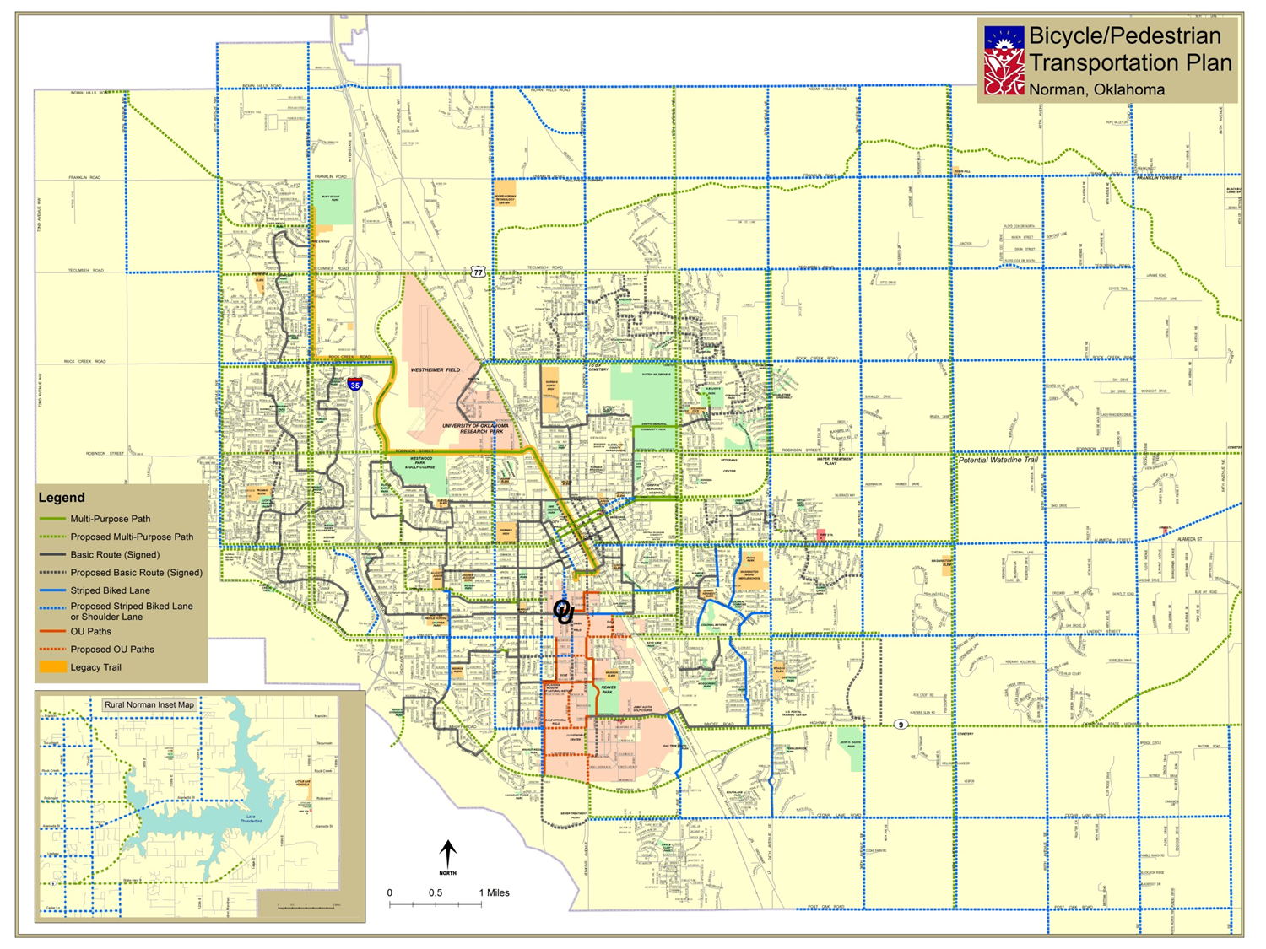
<?xml version="1.0"?><AllQuestions />
<?xml version="1.0"?><Settings><answerBulletFormat>Numeric</answerBulletFormat><answerNowAutoInsert>No</answerNowAutoInsert><answerNowStyle>Explosion</answerNowStyle><answerNowText>Answer Now</answerNowText><chartColors>Use PowerPoint Color Scheme</chartColors><chartType>Horizontal</chartType><correctAnswerIndicator>Checkmark</correctAnswerIndicator><countdownAutoInsert>No</countdownAutoInsert><countdownSeconds>10</countdownSeconds><countdownSound>TicToc.wav</countdownSound><countdownStyle>Box</countdownStyle><gridAutoInsert>No</gridAutoInsert><gridFillStyle>Answered</gridFillStyle><gridFillColor>0,0,0</gridFillColor><gridOpacity>100%</gridOpacity><gridTextStyle>Keypad #</gridTextStyle><inputSource>Response Devices</inputSource><multipleResponseDivisor># of Responses</multipleResponseDivisor><participantsLeaderBoard>5</participantsLeaderBoard><percentageDecimalPlaces>0</percentageDecimalPlaces><responseCounterAutoInsert>No</responseCounterAutoInsert><responseCounterStyle>Oval</responseCounterStyle><responseCounterDisplayValue># of Votes Received</responseCounterDisplayValue><insertObjectUsingColor>Blue</insertObjectUsingColor><showResults>Yes</showResults><teamColors>User Defined</teamColors><teamIdentificationType>None</teamIdentificationType><teamScoringType>Voting pads only</teamScoringType><teamScoringDecimalPlaces>1</teamScoringDecimalPlaces><teamIdentificationItem></teamIdentificationItem><teamsLeaderBoard>5</teamsLeaderBoard><teamName1></teamName1><teamName2></teamName2><teamName3></teamName3><teamName4></teamName4><teamName5></teamName5><teamName6></teamName6><teamName7></teamName7><teamName8></teamName8><teamName9></teamName9><teamName10></teamName10><showControlBar>Slides with Get Feedback Objects</showControlBar><defaultCorrectPointValue>100</defaultCorrectPointValue><defaultIncorrectPointValue>0</defaultIncorrectPointValue><chartColor1>187,224,227</chartColor1><chartColor2>51,51,153</chartColor2><chartColor3>0,153,153</chartColor3><chartColor4>153,204,0</chartColor4><chartColor5>128,128,128</chartColor5><chartColor6>0,0,0</chartColor6><chartColor7>0,102,204</chartColor7><chartColor8>204,204,255</chartColor8><chartColor9>255,0,0</chartColor9><chartColor10>255,255,0</chartColor10><teamColor1>187,224,227</teamColor1><teamColor2>51,51,153</teamColor2><teamColor3>0,153,153</teamColor3><teamColor4>153,204,0</teamColor4><teamColor5>128,128,128</teamColor5><teamColor6>0,0,0</teamColor6><teamColor7>0,102,204</teamColor7><teamColor8>204,204,255</teamColor8><teamColor9>255,0,0</teamColor9><teamColor10>255,255,0</teamColor10><displayAnswerImagesDuringVote>Yes</displayAnswerImagesDuringVote><displayAnswerImagesWithResponses>Yes</displayAnswerImagesWithResponses><displayAnswerTextDuringVote>Yes</displayAnswerTextDuringVote><displayAnswerTextWithResponses>Yes</displayAnswerTextWithResponses><questionSlideID></questionSlideID><controlBarState>Expanded</controlBarState><isGridColorKnownColor>True</isGridColorKnownColor><gridColorName>Yellow</gridColorName><AutoRec></AutoRec><AutoRecTimeIntrvl></AutoRecTimeIntrvl><chartVotesView>Percentage</chartVotesView><chartLabelsColor>0,0,0</chartLabelsColor><isChartLabelColorKnownColor>True</isChartLabelColorKnownColor><chartLabelColorName>Black</chartLabelColorName><chartXAxisLabelType>Full Text</chartXAxisLabelType></Settings>
<?xml version="1.0"?><AllAnswers />

Slide 16
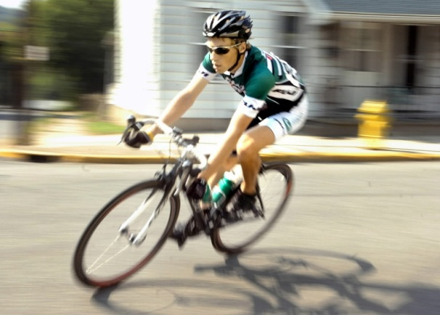
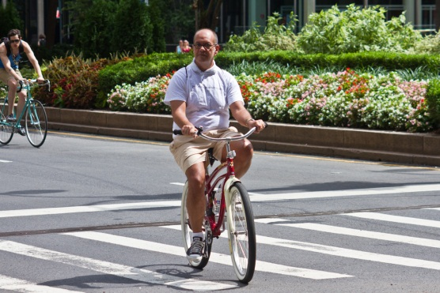
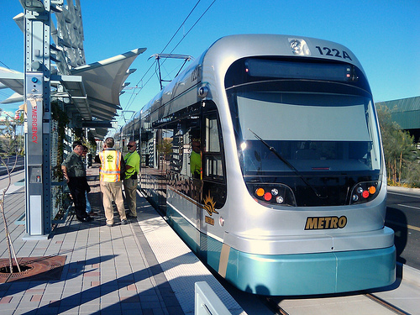
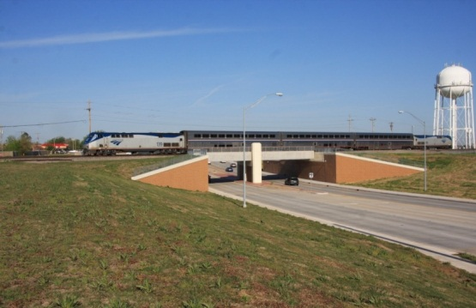
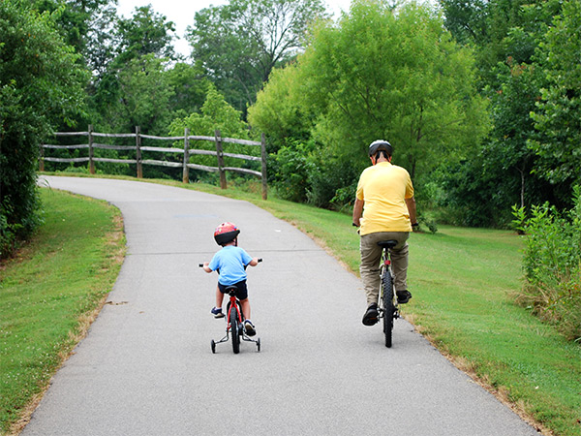
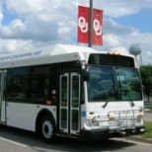
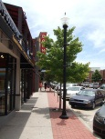
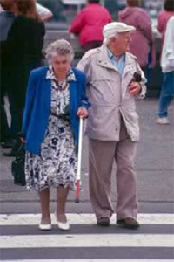
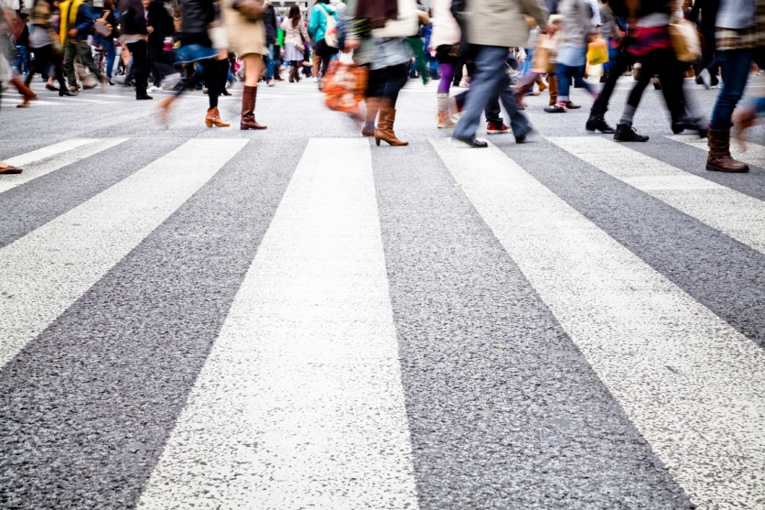
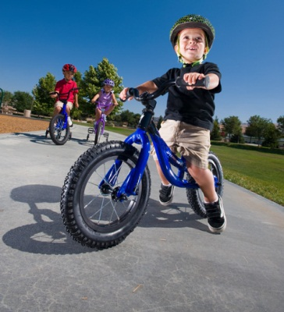
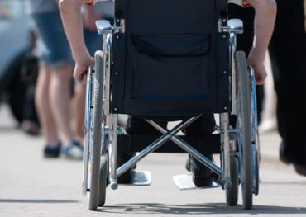
The Key Word is MULTIMODAL

Slide 17
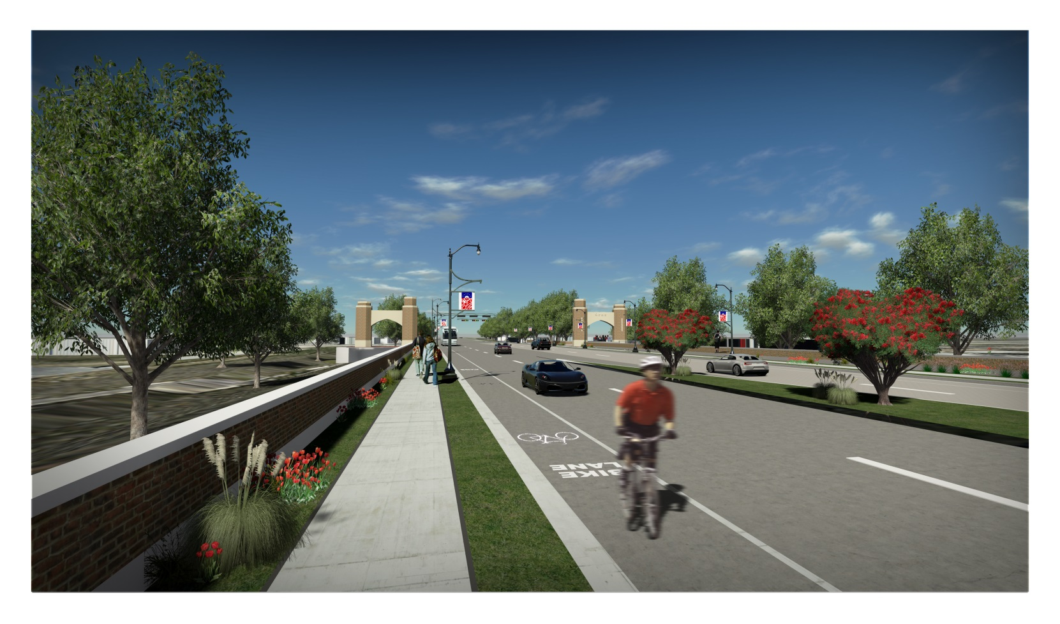
The Key Concept is COMPLETE STREETS
West Lindsey Street

Slide 20
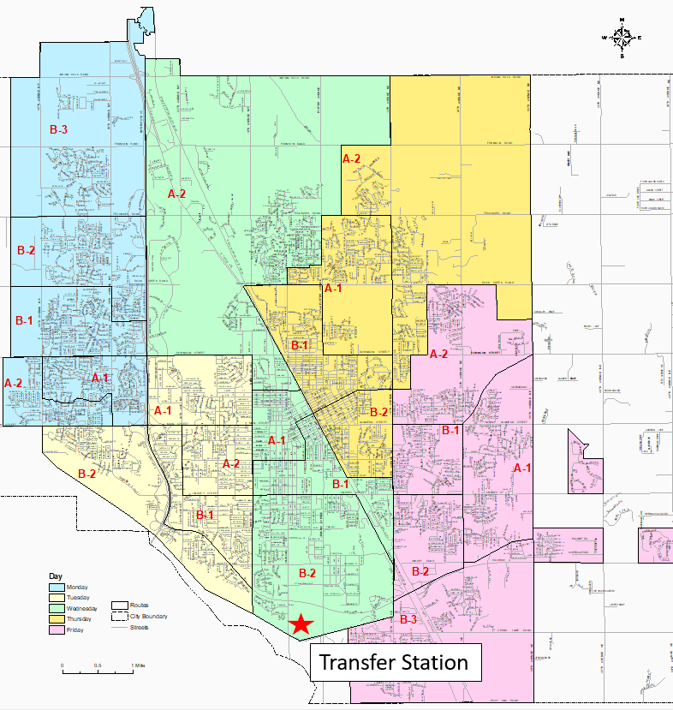
Solid Waste and Urban/Recycling Service Area

Slide 21
Reasons for a New Comprehensive Plan
Current plan is 18 years old and expires in 2025
Population and housing growth since 2000
  2000 Population: 97,000
  2022 Population: 131,500
  36% Growth
  Population density of 735 people per square mile
Numerous Land Use Plan Amendments since adoption
Increase in multi-family/private student housing units construction in the last ten years, Core Area
OTA Proposal for two Turnpikes

Slide 22
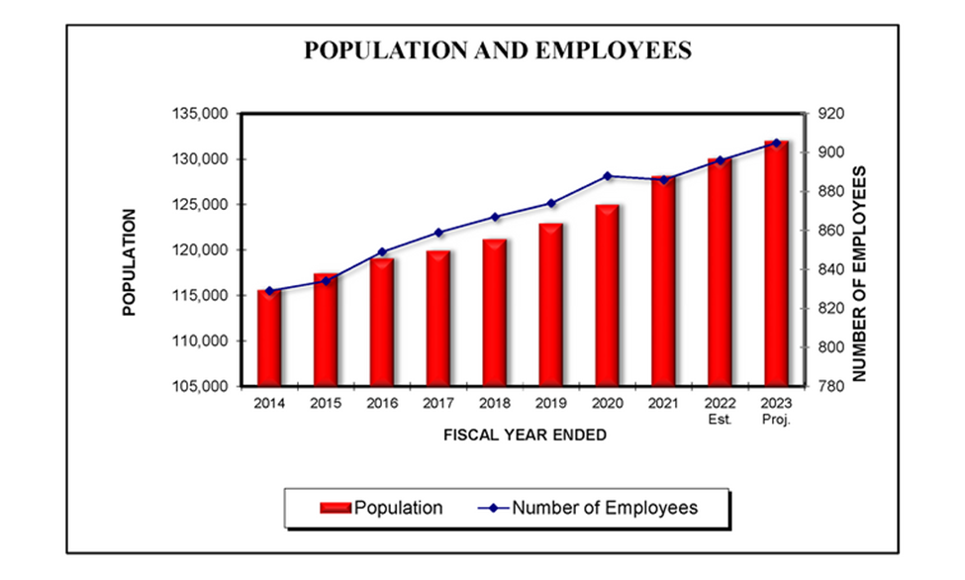
2023 Information

Slide 24
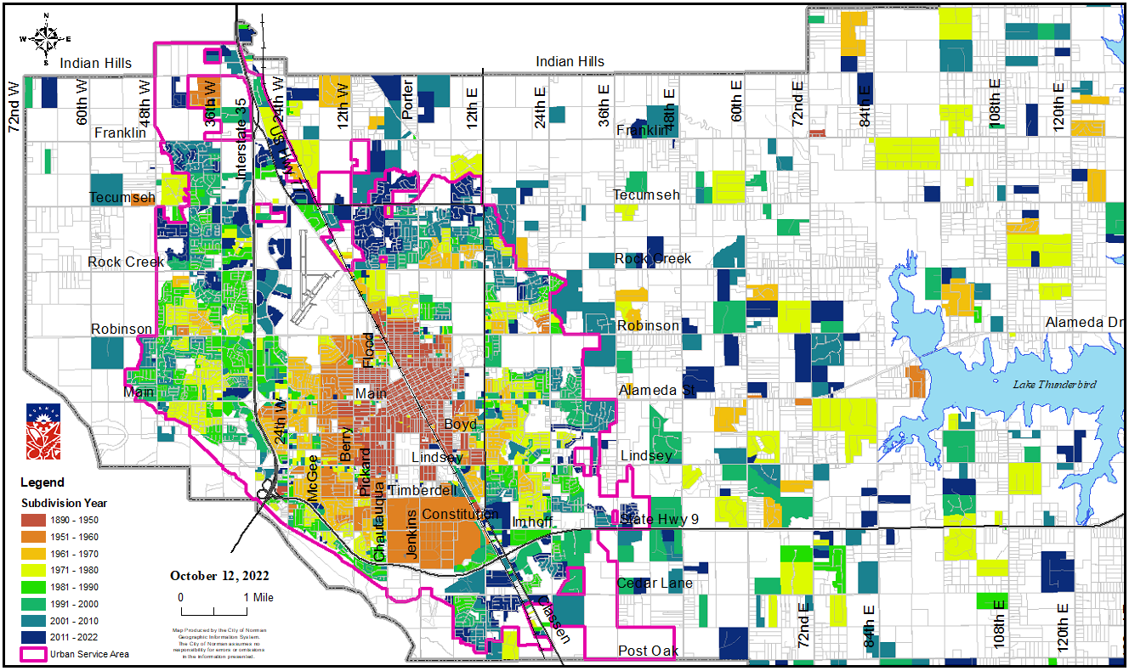
Urban Service Area - Key

Slide 25
Project Goals
Develop a Comprehensive Plan to guide future development in conjunction with incorporation of Comprehensive Transportation Plan, Stormwater Master Plan & Utilities Master Plans

Slide 26
Plans & Studies
Comprehensive Plan
Housing Market Analysis
Comprehensive Transportation Plan Update
Stormwater Master Plan Update
Water Hydraulic Modeling Update
Wastewater Master Plan
Sanitation Master Plan

Slide 27
Comprehensive Plan
Both a physical plan and a policy guide
Executive Summary
Easily distributed
Paper and digital format

Slide 28
Consultant Engagement Strategy
Work with Steering Committee
Innovative & creative approach to ensure participation
Latest engagement techniques
Develop a public engagement strategy –
  Citizen participation in various formats/venues throughout the process to engage different demographics and geographic locations

Slide 29
Proposal Content
    Transmittal Letter
    Table of Contents
    Executive Summary
    Project Approach
    Public Participation Approach
    Project Team
    Experience of Project Team with same or similar Planning and Infrastructure Experience
    Anticipated schedule
    Appendices (misc., exhibits, illustrations, etc.)
    Proof of Insurance
    References

Slide 30
Project Schedule
Milestone | Schedule
RFP Released | September 30, 2022
*Pre-proposal Conference | October 13, 2022 November 3, 2022
Questions Due to the City | October 20, 2022 November 10,2022
Responses Posted | October 28, 2022 November 16, 2022
Proposals Due to the City | November 10, 2022 December 1, 2022
Proposal Evaluation and Interviews | November – December 2022 December 2022 – January 2023
Contract Negotiations and Contract Award by City Council | December 2022 – January 2023 January – February 2023

Slide 31
QUESTIONS OR COMMENTS?

